Slide 1
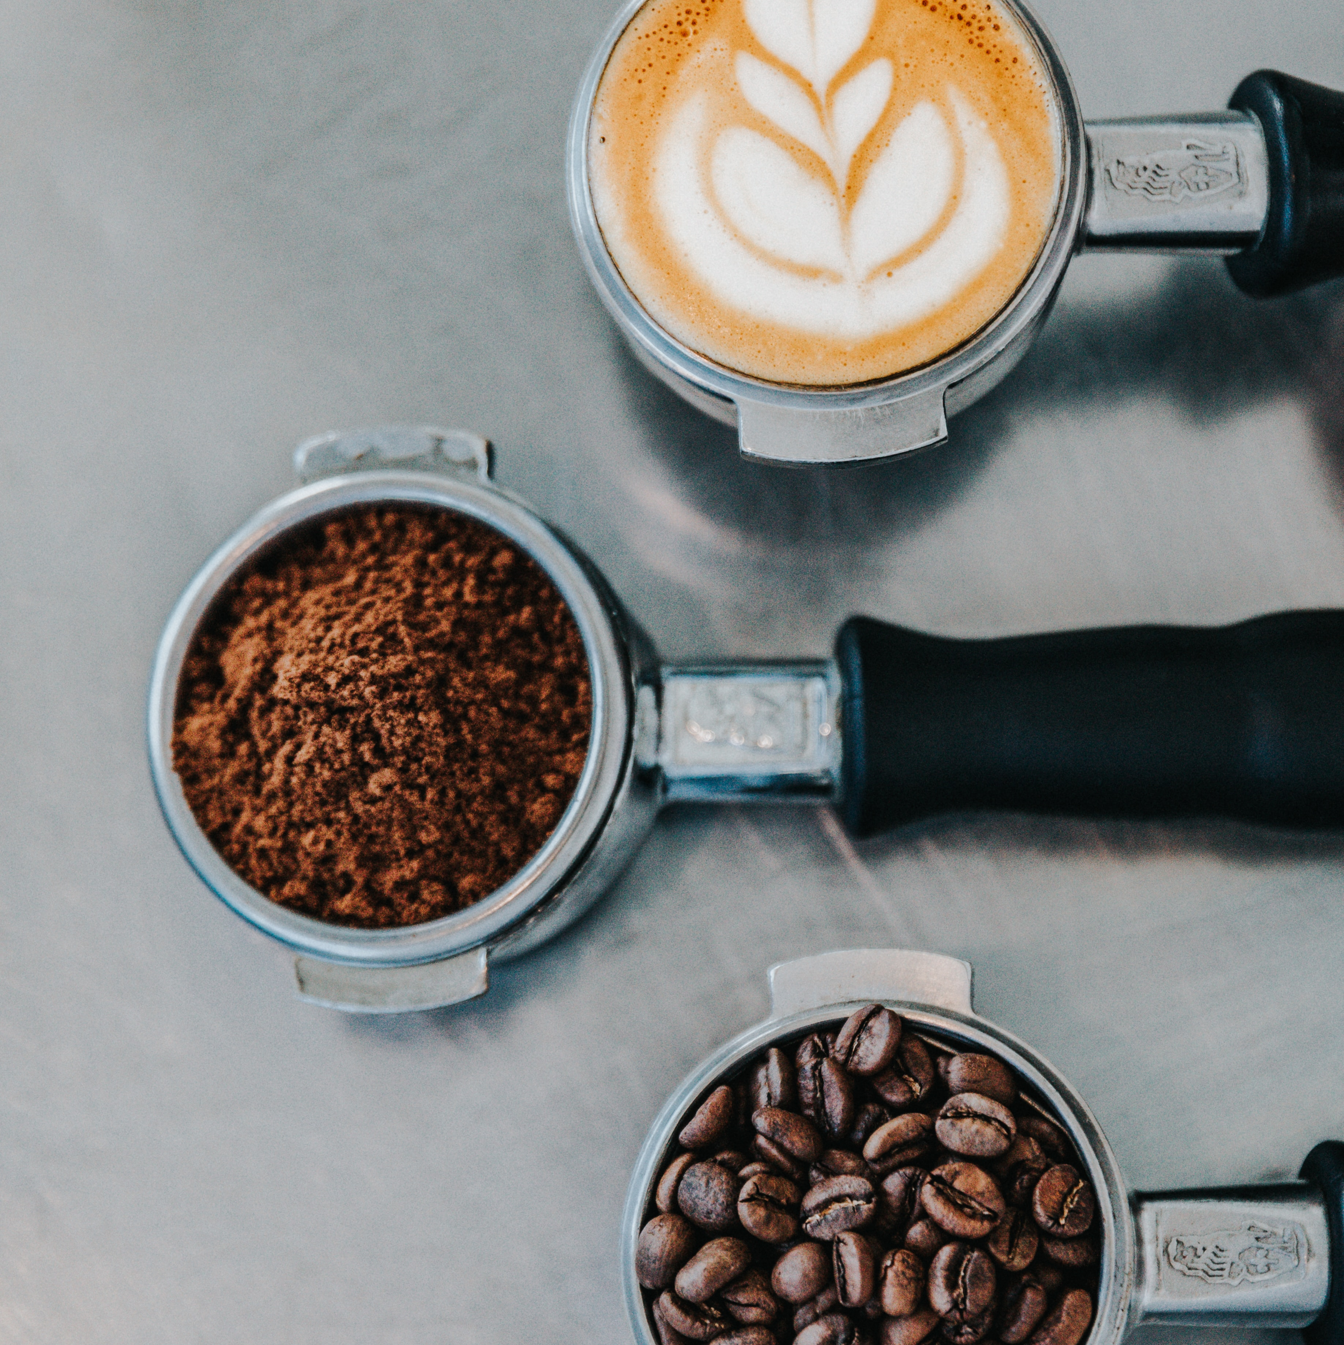
Global Coffee Trade
Cindy Wong & Sandra Botica
Notes:
Photo by
https://unsplash.com/@nate_Dumlao
Nathan Dumlao on
https://unsplash.com/photos/zUNs99PGDg0
nathan-dumlao-Y3AqmbmtLQI-unsplash.jpg
Photo by Nathan Dumlao on Unsplash

Slide 2
Data Story
The number of countries producing (exporting) coffee and what volume?
The number of countries buying (importing) coffee and what volume?
Price paid to growers.
Retail price.
Notes:
4 parts to this data story. 1990-2019, but more about the data later.
Exports (55 countries)
Imports (35 countries)
Countries, continents, volume in Thousand 60kg bags, Information derived from monthly reports.
Price paid to growers (62 countries)
US cents/lb as an annual average. (Keep in mind that 60kg is 132.277 pounds i.e. 1 kg = 2.20462 pounds)
Avg price paid to to grower at farmgate
OR min price guaranteed by the gov to the grower by form and weight reported in the national currency in which the coffee is purchased, converted to US cents/lb.
Coffee-type
Colombian Mild(27/62 countries)
Other milds(27/62 countries)
Brazilian Naturals(27/62 countries)
Robustas(27/62 countries)
Retail price (28 countries)
(Global price of coffee)
US $/lb as an annual average.
Price paid by consumer to commercial distributor outlet.

Slide 3
Data Story
Have exports and imports risen over time?
Links between trade volumes and prices to inflation and economic growth.
What are exporters doing to prepare for scale of growth in their coffee trade?
Do importers have access to exporters and growers to source coffee for the potential growth in their trade?
Notes:
Who is our target audience?
Question for the audience - When budgets are tight do we spend less on coffee?
Discuss What affects the price of coffee. See image in SLACK that Cindy researched.
Coffee as a discretionary item. Inflation and low economic growth, consumers buying less.
Supply factors affecting price(as a commodity) e.g. climate, inventories, supply chain disruptions, no of producing countries, investment.
Demand.

Slide 4

Data Source
International Coffee Organization
Historical Data on the Global Coffee Trade
https://www.ico.org/new_historical.asp
Notes:
Started with a Kaggle website
https://www.kaggle.com/datasets/michals22/coffee-dataset?select=Coffee_domestic_consumption.csv
Then found the International Coffee Organization, selected 4 excel spreadsheets of historical data.
View of original data source to cleaned csv.
Numerous blank rows, subtitles for regions in rows, coffee type columns.
Tried this in python and then excel.
A lot of null values, but still relevant or insightful to the story.
Csv’s in cleaned resources folder.
Photo
https://www.dreamstime.com/photos-images/coffee.html

Slide 5
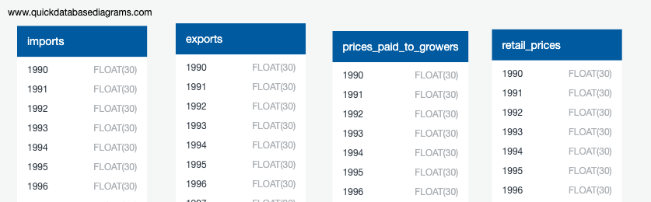
Database
QUICK DBD
Export PostgreSQL
pgAdmin4
Created 4 tables, import data from Resources files
Notes:
Pivoted tables (thousand of rows e.g. country 1990, country 1991 to 2019, then next country, next csv…..crazy idea)
Unpivoted tables so that one row was a dictionary for a country, with key:value pairs being Year:value (volume or price) API data links.
Also, experimented with joins of 4 tables to create 1 file for the API.
Created a database.
Experimented with Mongodb.
Switched to SQL.
Had difficulty in setting up Flask API in app.py
Had to use username and password to coffee database in postgressql. Very new concept.
I wasn’t able to select/connect data using Base = automap_base() Base.prepare(autoload_with=engine) so no references to tables Coffee = Base.classes.coffee
Hence had written app.py syntax using this methodology with no return in python experiment.
Changed to reading sql.

Slide 6
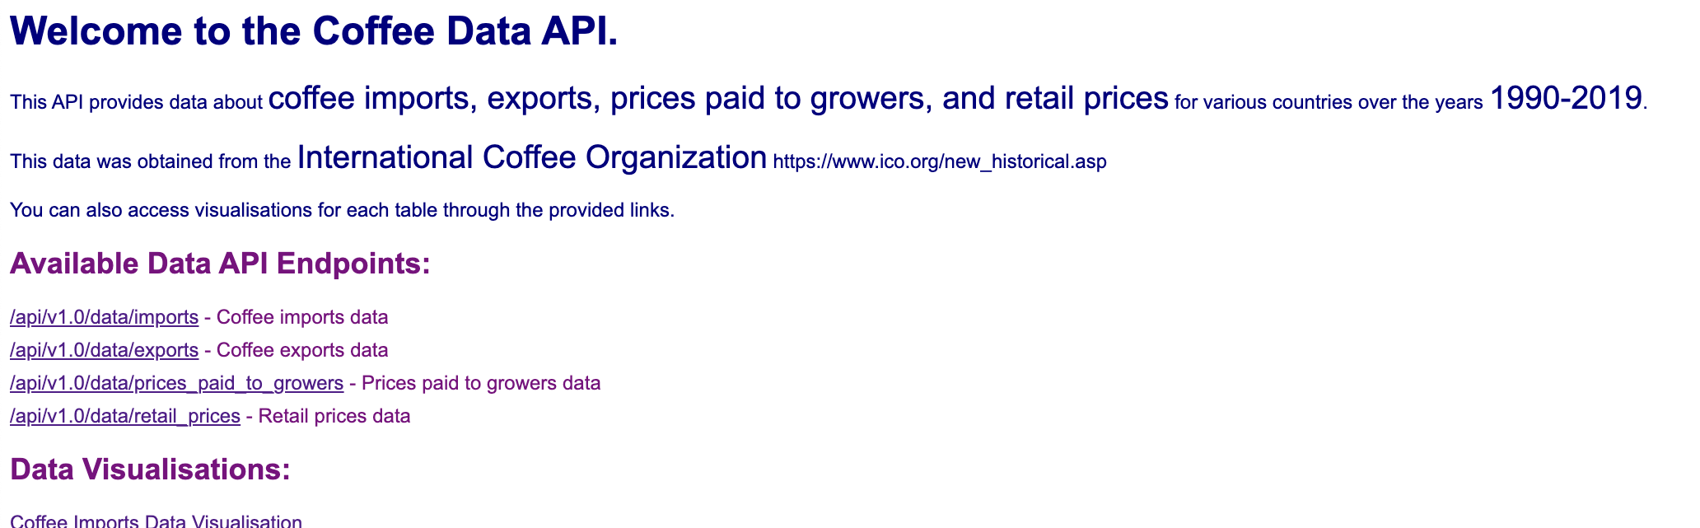
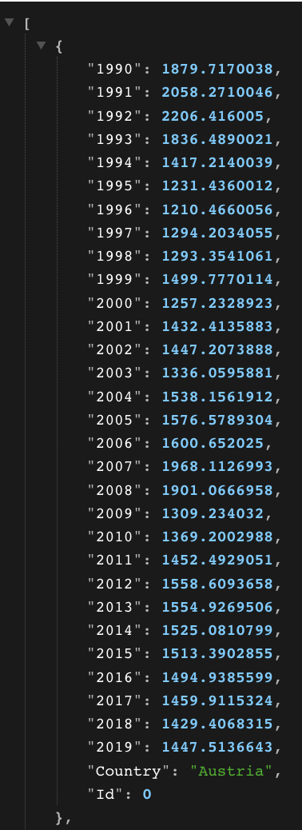
Python Flask API & Plotly
app.py
index.html
javaScript, css, html

Slide 7
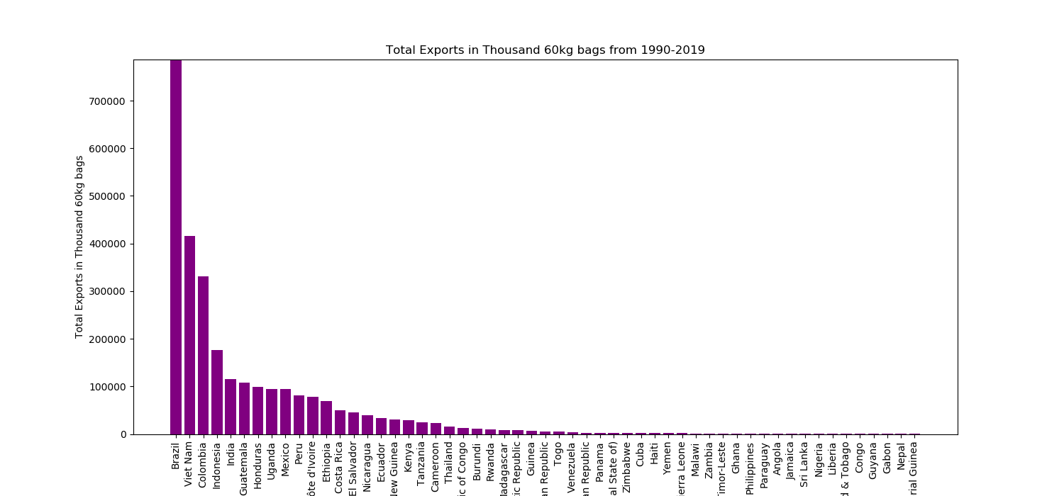
The number of countries producing (exporting) coffee and what volume?

Slide 8
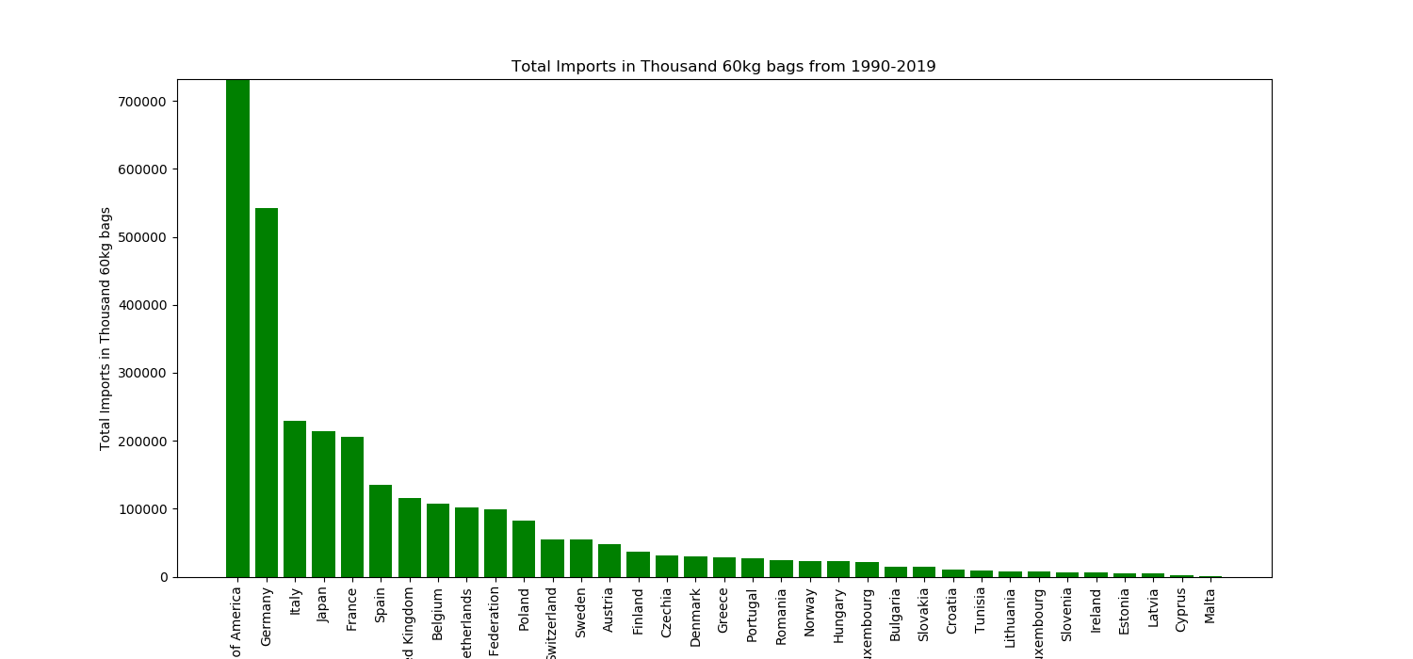
The number of countries buying (importing) coffee and what volume?

Slide 9
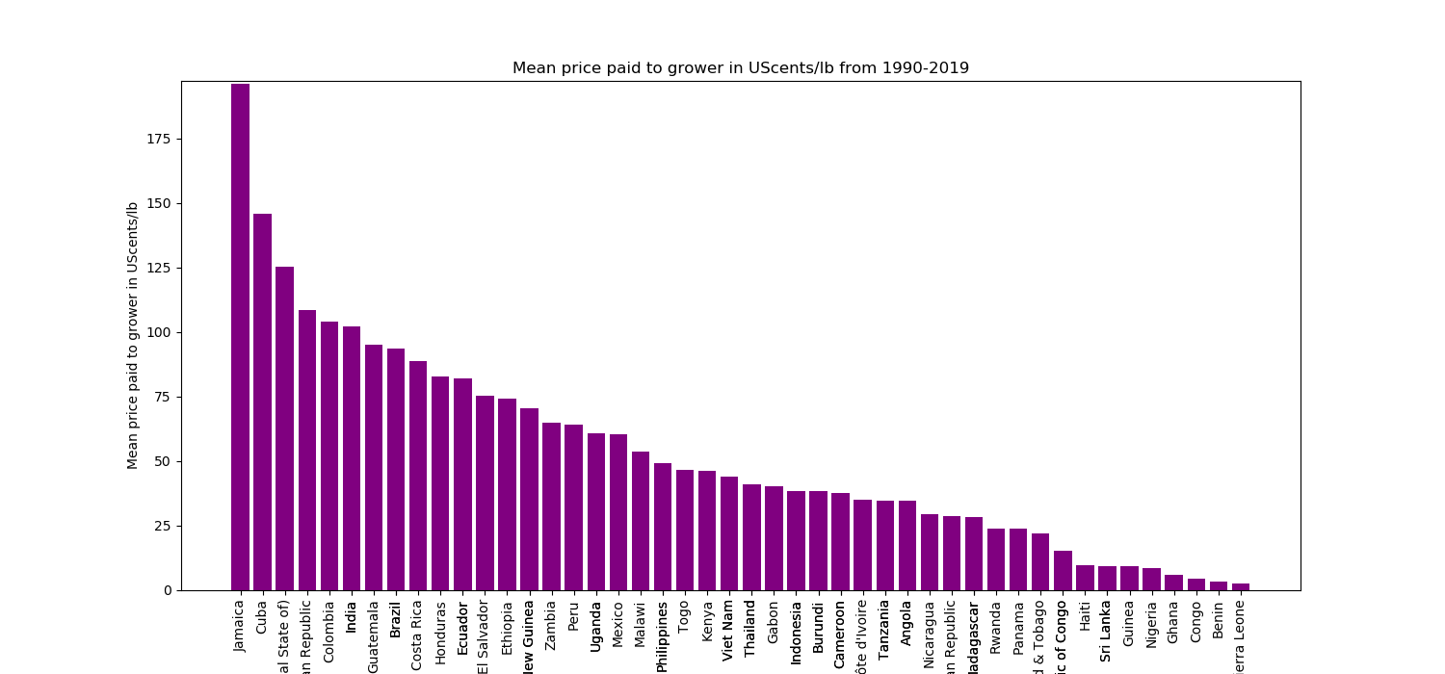
Price paid to growers.

Slide 10
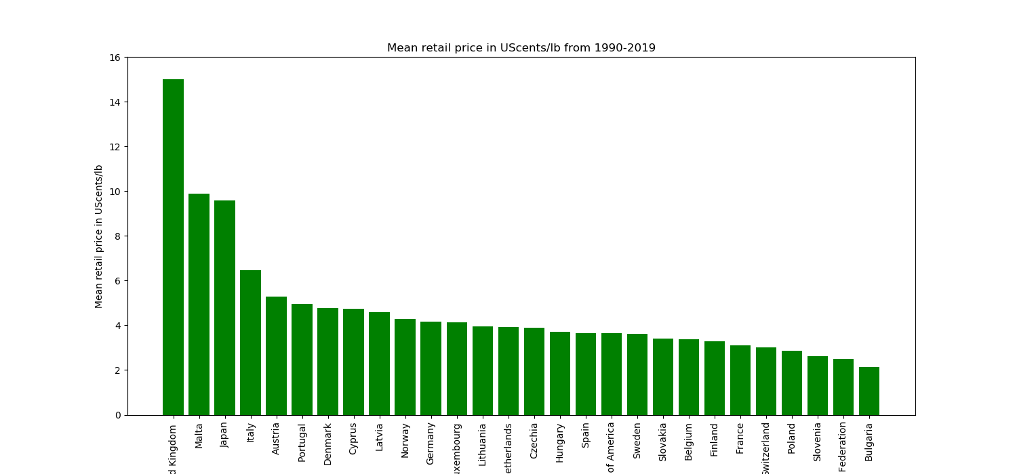
Retail price.

Slide 11
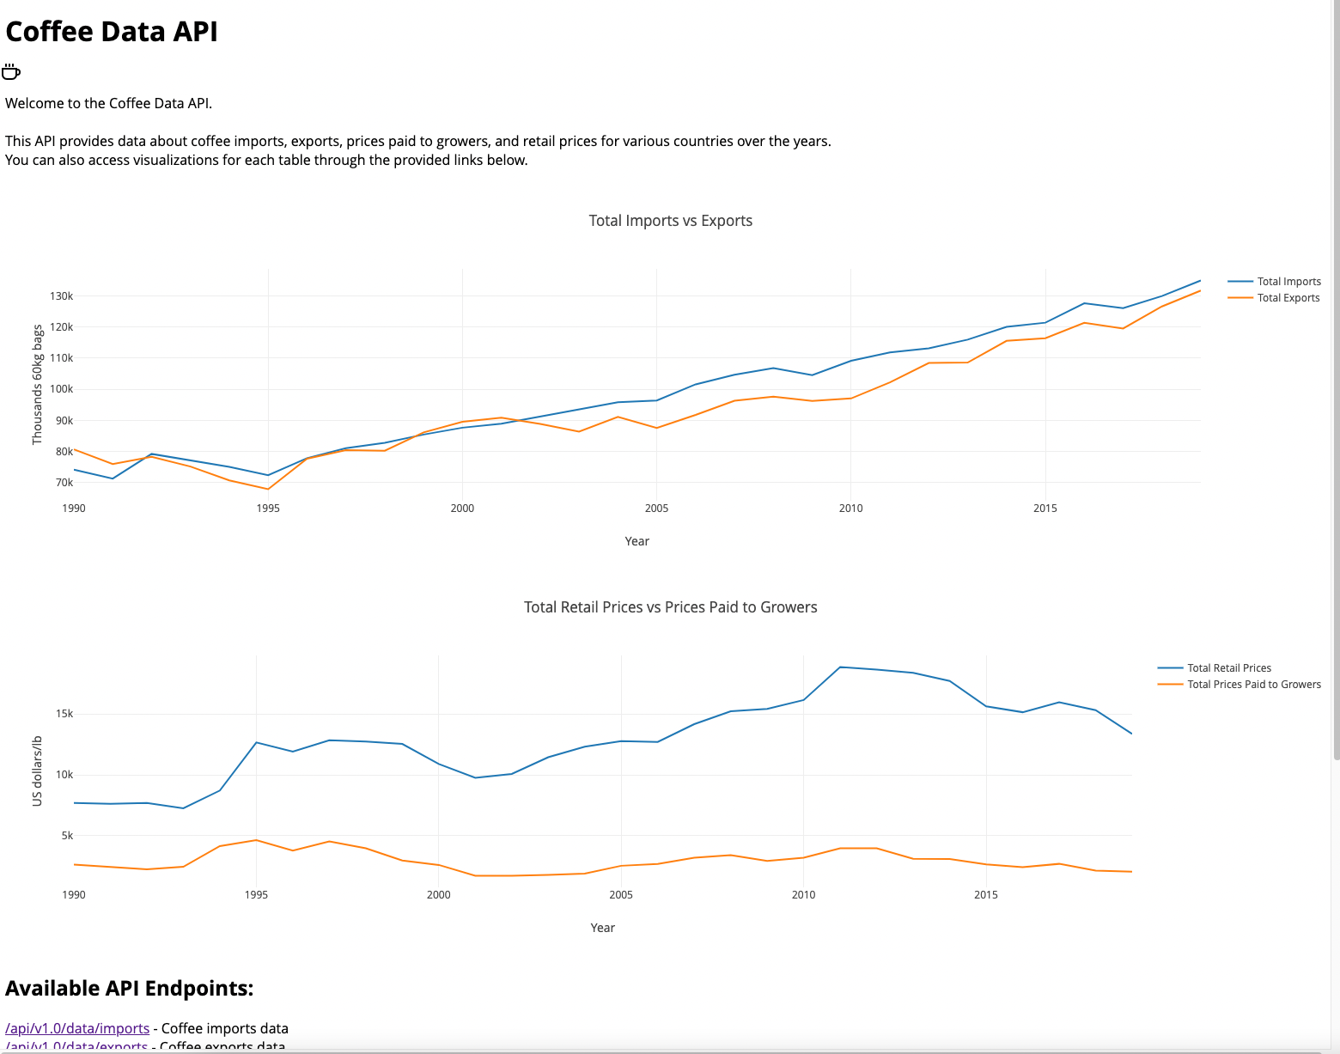
Comparison

Slide 12

Initial Story & Questions that arose

Slide 13

Conclusion & Questions

